Slide 1
March Final Year Project Demo
By Caroline Percy

Slide 2

What am I doing?
I want to create a hidden object game.
I want the art assets to be given by a third party.
This will be through REST API.

Slide 3

What is A hidden object game?
They are video games that task the player to find an object within a busy landscape
They will often ask you to find several objects in one scene
There will also be objects called distractors

Slide 4
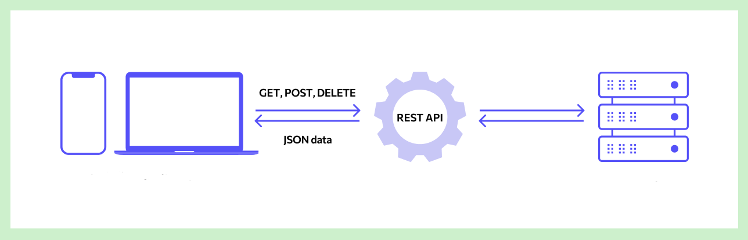
What is REST api?
REST API is an interface that two systems use to transfer information
It is defined by a set of constraints to keep it reliable and secure (REST)
A request is sent to the server in form of a URL, and a reply is sent back, often in JSON form.

Slide 5
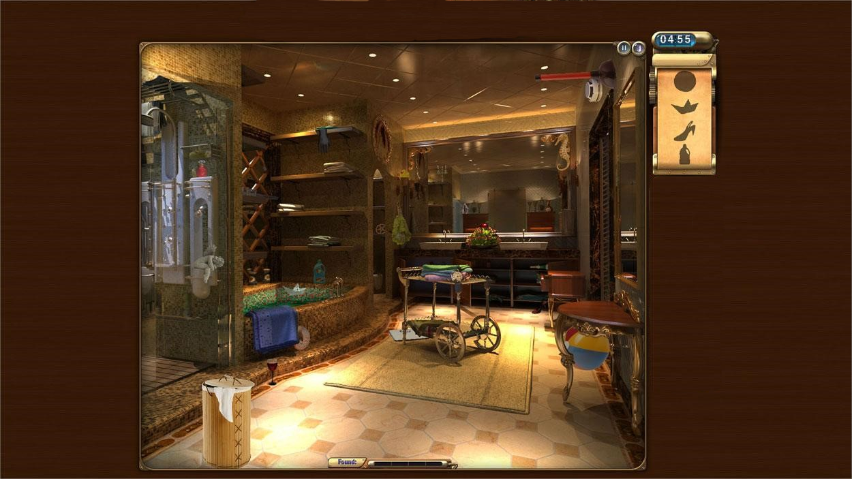

Slide 6
Why am I Doing it?
Hidden object games are often underestimated for their simplicity and lack of challenge
If my research questions succeed, it could change the speed and cost of making 2D games
This would also result in more niche ideas and creativity

Slide 7
My Research question(s)
Can I make a hidden object game that relies on a third party to deliver the game assets dynamically?
Will such a game be seamless to the player? Can I make levels theme-based?

Slide 8
What am I using for this?

Slide 9

Python and pygame
I decided to use Pygame and Python
Pygame is module for Python, specifically for making games
I have little experience with both, so I wanted to challenge myself

Slide 10

Pixabay
Pixabay is a website where people upload and share royalty free images, videos and music.
It has inbuilt REST API that can be accessed freely.
I will be working with this to draw art into my game at runtime.

Slide 11
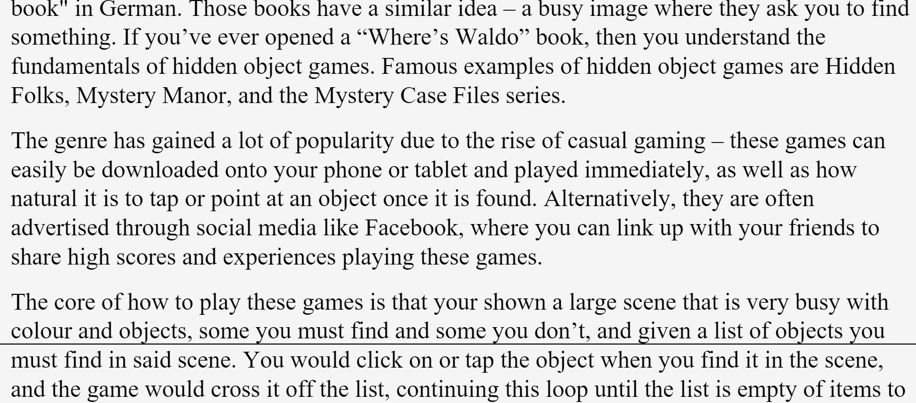
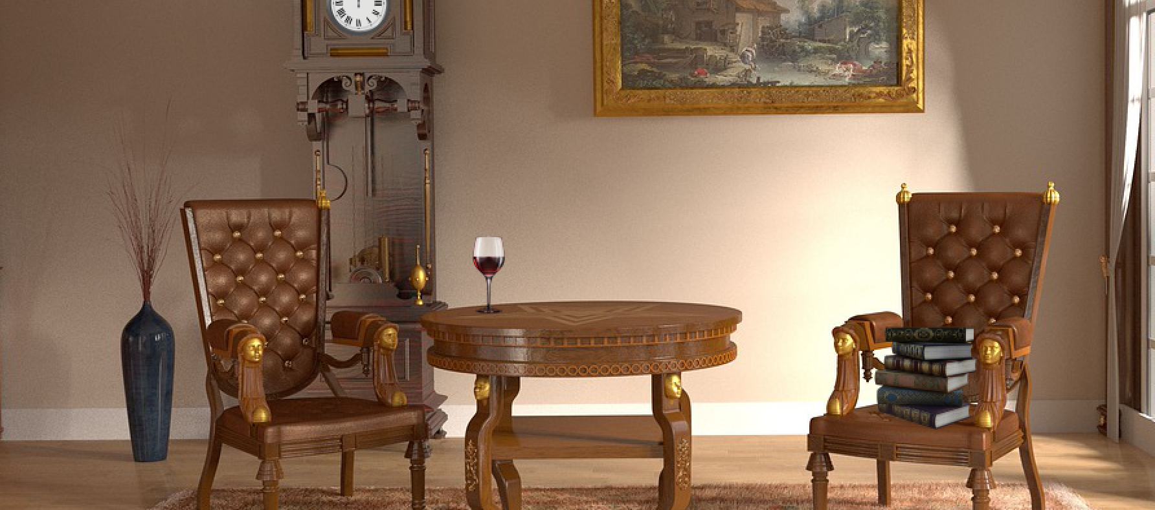

What I have done thus far?
Most of my Project Report
A Standard Level
Dynamic Pixabay implementation
The written work from before Christmas.
A full level of the game is now available. Includes a timer, a reset button and an exit button.
I have a search bar to choose out the first Pixabay image related to your search.
I plan to expand on this to create full levels using this search function.

Slide 12

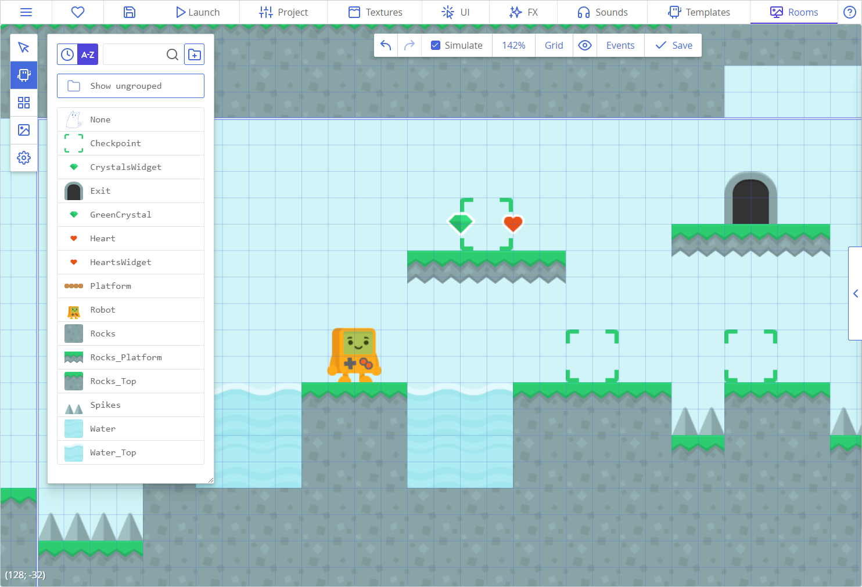
What’s Next?
Documentation
Game Editor

Slide 13
Thank you for Listening!
Any questions?

